Slide 1
(Name) Regional WOCN Conference
The Basics of Recertification by the WOCNCB’s Professional Growth Program (PGP)
by (your name here)

Slide 2
Why recertify by PGP?
The WOCNCB established the PGP to recognize activities which go beyond routine WOC practice or which represent progression of practice along the novice-to-expert continuum. This allows certificants to demonstrate their knowledge of wound, ostomy & continence nursing by tracking and recording evidence of their continual learning and professional growth.

Slide 3
What are benefits of PGP?
Reflects professional practice
Demonstrates expanded practice
Details learning
Demonstrates competency
Documents knowledge and achievements
Documents clinical and educational accomplishments
Helps achieve your career goals

Slide 4
Eligibility Requirements
Hold current RN licensure.
Hold current WOCNCB certification in all specialties in which recertification is sought.
It is NOT permissible to recertify by PGP if you first FAIL the examination for that recertification period.
Use current WOCNCB Handbook.

Slide 5
Point Requirements for Recertification by PGP
Each specialty that you are recertifying in (Wound, Ostomy, Continence) requires 80 PGP points. Of those 80 points, 40 must directly relate to the specialty.
For example: If you are recertifying your CWOCN credential, you will need 240 PGP points to successfully recertify – that’s 80 x 3 specialties, or 240 points

Slide 6
How to determine point values
PGP Activity List gives point values by activity.
Website “Ask the Board”
“Pre-Approval for activity not defined” submit one month prior to recertification for point determination.
A project can only count once!

Slide 7
PGP Activities
The portfolio process is flexible – you can include PGP points from nine Categories
✓ Continuing Education ✓ Professional Organizations
✓ Projects ✓ Academics
✓ Research ✓ Self Assessment
✓ Publications ✓ Preapproval
✓ Teaching
Important: Your portfolio MUST contain 10 points from Continuing Education that relate to the clinical focus. You may include up to 40 Continuing Education credits.

Slide 8
Using the PGP Online Forms
Your portfolio includes a summary/ table of contents of all the activities you have submitted within each specialty.
The Summary is your checklist in obtaining the total number of points that you are claiming for recertification

Slide 9
Using the PGP Online Forms
Sample Summary: Wound
Description | Date(s) | Total Points
Total CEU’s | 2011 – 2015 | 30
Venous Ulcer Clinical Pathway | 6/15/2011 | 25
Newsletter Article: Living with Venous Ulcers | 2/7/2012 | 5
Poster: Atypical Venous Ulcer | 7/6/2012 | 10
Advanced Assessment | 2013 | 10
Self Assessment | 2014 | 5
TOTAL PGP POINTS |  | 85

Slide 10
Verification
Provide verification by including descriptive details of the project or activity.
You MUST fill out each answer completely for EACH activity contained in the portfolio.

Slide 11
Category: Continuing Education
Required: A minimum of 10 PGP points directly related to the specialty. A maximum of 40 PGP points are allowed. You may not have more than 10 in professional practice.
Point calculation: 1 PGP point for each CE credit. A Contact Hour (CE credit): 60 minutes = 1 PGP Point

Slide 12
Category: Continuing Education
List each individual educational session or course title separately on CEU verification form.
If the courses are earned at a single Conference, you may list all sessions that directly relate to the specialty as one entry with the total CE’s. You must separate the Professional Practice sessions from that Conference as one entry. You must list the individual topics with the hours/CE’s for each.
It is not acceptable to transfer points from one specialty to another – so points related to wound or ostomy cannot be applied to the continence specialty.

Slide 13
Category: Continuing Education
WOCN Professional Practice has to directly impact your role as WOC Nurse.
These sessions would count:
Marketing Your Business
Legal Issues
Integrating Technology and Outpatient Billing/Reimbursement
These sessions would NOT count:
IV Therapy
Basic Life Support (BLS)
Creating the Environment of Safety: Healthcare Delivery Compass
High Risk Medications
Preparing for the Magnet Journey

Slide 14
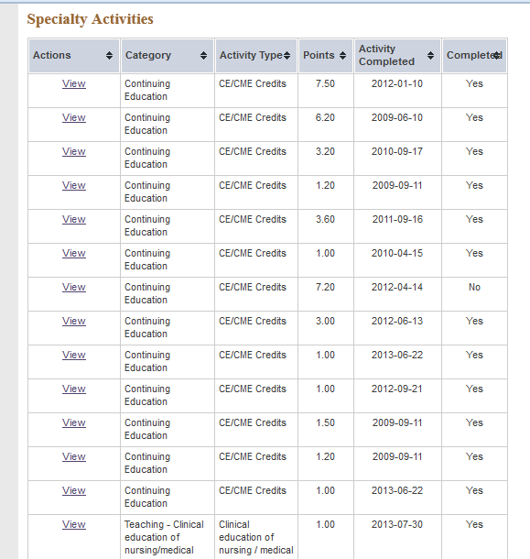
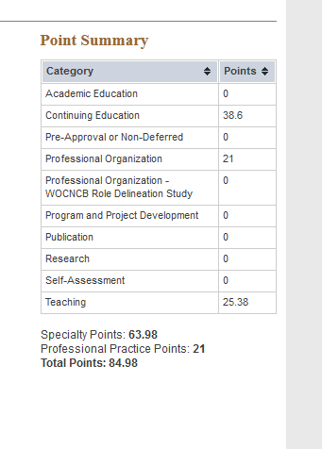
Category: Continuing Education
Summary

Slide 15
Category: Project/Program Development
Verification
Date Activity Completed:____________
For Quality Improvement, summarize your project by
answering the following questions:
  What was the problem?
  How was the problem identified?
  What actions were implemented to correct the problem?
  How long did you evaluate the action plan?
  What were the results of the project?

Slide 16
Category: Project/Program Development
Summarize the purpose and/or assessment of need for your program/ project
Provide an overview of the implementation of your program / project
Evaluate the program / project by discussing the implications for clinical practice

Slide 17
Category: Project/Program Development
EXAMPLE
Date Activity Completed: May 2011
Summarize purpose and/or assessment of need of program/project.
Due to the large number of patients with venous ulcers the development of a clinical pathway was necessary to ensure quality care.
Provide an overview of implementation of program / project.
The clinical pathway was developed based upon standards of care. It was presented to the nursing and medical staff before implementation.

Slide 18
Category: Project/Program Development
EXAMPLE Continued
Evaluation of program / project (implications for clinical practice).
Since the implementation of the venous ulcer pathway, patients are receiving consistent care based on evidence-based practice.
PGP Points Claimed for This Activity: 25

Slide 19

Category: Teaching Activities

Slide 20
Category: Teaching Activities
Minimum Points Required = None
Maximum Points Allowed =70
Acceptable Activity PGP Points
1. Presentations/lectures 1 point per 15 min
(CEU or non-CEU) of presentation
(Examples: in-service, seminar, lecture, clinical conference, written, electronic or video
learning modules.)
2. Conference poster presentation 10 points

Slide 21
Category: Teaching Activities
Minimum Points Required = None
Maximum Points Allowed =70
Acceptable Activity PGP Points
3. Precepting WOC Nursing Students 1 point/4 hours
4. Clinical education of nursing or
other medical professional 1 point/8 hours
(e.g., orienting, mentoring, job shadowing,
precepting)

Slide 22
Category: Teaching Activities
Acceptable Activity PGP Points
5. Expert Consultation at Medical Event 1 point (max 3)
6. Developing an Education Program 2 points per 15 min.
(CEU or non-CEU) of presentation
7. Additional points for programs 5 points per program
awarded CEUs
(must be the primary coordinator or
administrator on the planning committee)
8. Revising an education program 1 point per 15 min.
(must have significant content change,
updated references, etc.)

Slide 23
Precepting Forms
WOCNCB Form from website Tracking form made by CWOCN

Slide 24
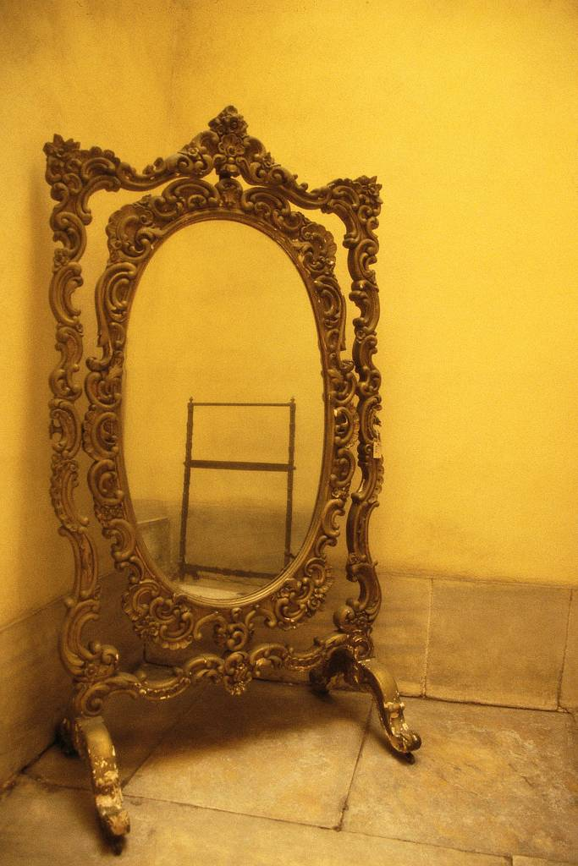
Category: Self-Assessment of PGP Process
The Self Assessment Category was developed to assess the impact that the Professional Growth Program has on you as a wound, ostomy, or continence nurse.

Slide 25
Category: Self-Assessment of PGP Process
Minimum Points Required = None
Maximum Points Allowed = 5 per specialty
Choose one specific activity from your PGP portfolio and describe in detail how completing the activity
- increased your expertise,
- validated your expertise
- and enhanced your professional growth.

Slide 26
Category: Self-Assessment of PGP Process
Example
Identify how the PGP process impacted you professionally by describing processes that prepared you to achieve points in your selected category.
As the new incontinence guidelines were updated on the CMS manual for long term care facilities, I felt I needed to increase my knowledge of these guidelines. I downloaded the changes to the manual and reviewed the documents. I then reviewed recent articles written since 2012 and started to plan how to apply this to my practice. It led me to develop an in-service for catheter care.

Slide 27
Category: Self-Assessment of PGP Process
Identify two strengths and two challenges in your current WOC practice.
My strengths:
1. Knowledge of in-dwelling catheter care
2. Knowledge of straight cathing
My challenges:
1. Prevention of UTIs in long term care
2. Increasing staff knowledge of treating specific types of incontinence

Slide 28
Category: Self-Assessment of PGP Process
Define two goals to help you build your professional growth over the next five years, define two goals using a timeframe and plan. Use the strengths and challenges you already identified. (Note: Your response is for self assessment and will not be measured for completion.)
My Goals:
1. Increase level of knowledge with differences of urinary incontinence of staff nurse in long term care facilities, using in-services within next two years.
2. Review care plans at facility for prevention of UTI’s and identify areas of weakness and revise them within two years.
PGP Points Claimed for This Activity: 5

Slide 29
What’s New in 2014?
Limit to 2 Revisions (initial submission, 1st revision, 2nd revision)
Effective January 1, 2015 – Any “Professional Practices” (not the clinical specialty) CE course or portfolio activity item not WOCNCB® approved or WOCN® Society sponsored MUST be pre-approved via the pre-approval process.
New Activities:
Arranging Seminar/Symposium/ Educational Program
Conference Planning Committee at National or Regional /local/state level
Establish Independent Non-Clinical Practice, or, Independent Clinical Practice less than 50% of primary source of income (self employed)
Journal or Magazine article –
(non-peer reviewed)

Slide 30

Your Portfolio Checklist
Complete necessary verification of each activity
(online portfolio)
Be sure you have 80 PGP Points for each specialty

Slide 31
Your Portfolio Checklist
40 PGP points out of 80 required for each specialty must directly relate to that specialty
Continuing Education category requires 10 points directly related to the specialty in which you seek certification
You must complete the all CEU courses prior to your application deadline

Slide 32
Your Portfolio Checklist
Be sure your application includes
  Profile
  Verification of each activity using online portfolio
  RN license number (WOCNCB will verify)
  Recertification Fees

Slide 33
Submit Your Portfolio
Submit your Portfolio
No later than 3 Months prior to
Credentials Expiration
Example: June 30 for September 2014 expiration
www.wocncb.org/pgp

Slide 34
Fees
One specialty $395
Two specialties $510
Three specialties $610
Four specialties $670

Slide 35

What if I am Audited?
Auditing Process
The WOCNCB randomly selects portfolios and audits them with a thorough documentation review.
Be sure to review the PGP handbook to understand the documentation you will need if your portfolio is selected for auditing.

Slide 36
Documents Required for Audit
Documents for Audit are the ‘‘PROOF” that activity was done. These include: sign in sheets, copies of activities, letters of approval, acceptance letter, copy of presentation, transcripts, etc.
  Examples are listed at the bottom of the worksheets or verification form.
Do not send in with portfolio.

Slide 37
Top Ten Tips
Be sure you access the most current PGP Handbook at www.wocncb.org.
Begin compiling and filing the PGP materials early. Don’t wait until the year your certification expires to begin.
Keep accurate and detailed records of your WOC practice activities that count toward PGP points.
Points must be obtained by activities during the 5-year certification period and before submission of the recertification application.
Notes:
Point #3 I would put up a schedule, since we are having issues with people not submitting on time. I totally agree with that Patti. Maybe we can add that to this slide and make the 4th bullet point with an example. Quite a few people do not understand that the submission period is really deadline to deadline and not certification expiration date to cert expir date cuz they pass in their portfolio earlier than when they expire. I am sure someone can expound on this much better than I have here but it would be nice to get that point across.

Slide 38
Top Ten Tips
Check the deadlines! You must finish the required points prior to the application deadline.
If your Certification expires on this date, you must meet deadlines to avoid lapsing. | Your application deadline is | Your LATE application deadline is (Late Fee applies)
March 31 | Dec. 31 | Jan. 31
June 30 | March 30 | April 30
September 30 | June 30 | July 30
December 31 | Sept. 30 | Oct. 31

Slide 39
Top Ten Tips
Your portfolio must be submitted online.
Save time, effort, and confusion – keeping the portfolio near the required 80 points.
Review the eligibility requirements
Review PGP algorithm flowchart

Slide 40
Top Ten Tips
Ask for help!
If you have any questions:
- Call the WOCNCB Office 1-888-496-2622
- Visit the Web site at www.wocncb.org
- Submit a question to the “Ask the Board” section on the Web site

Slide 41
References
Hayes, E., Chandler, G., Merriam, D., & King, M. (2002) The master’s portfolio: validating a career in advanced practice nursing. Journal of the American Academy of Nurse Practitioners. 14(6), 119-125.
Shakespeare, P. (2002) Building portfolios. Nursing Management 9 (1), 30-33.
WOCNCB (2014) Professional Growth Program Handbook.

